Slide 1
Redlined and Left Behind: Housing Unaffordability and Displacement Risk in Charlotte, NC
05/04
2026
Ayia Boutanassa, Brady Dunn, Bryce Jackson, Eric Testen, Garrison High
DTSC 2302 Project 3

Slide 2
Motive/Topic
Key Findings
Regression Model
Classification Model
HOLC Equite Analysis
Conclusion
Ayia Boutanassa, Brady Dunn, Bryce Jackson, Eric Testen, Garrison High
05/04
2026
House Unaffordability & Displacement Risk

Slide 3
Topic Discussion
1
2
3
4
Ayia Boutanassa, Brady Dunn, Bryce Jackson, Eric Testen, Garrison High
05/04
2026
House Unaffordability & Displacement Risk
Rising Housing Costs in Charlotte / Difficulty of Homeownership
Concern about displacement in vulnerable neighborhoods
“What factors drive housing burden and displacement risk?”
Impact of historical redlining

Slide 4
Key Findings
GAM R² is about
XGBoost recall is about
Average precision is about
0.83
0.83
0.88
The key findings showed strong link between socioeconomic factors and outcomes. The patterns linked to historical inequality were still visible modern-day.
Ayia Boutanassa, Brady Dunn, Bryce Jackson, Eric Testen, Garrison High
05/04
2026
House Unaffordability & Displacement Risk

Slide 5
Regression Model Overview
Ayia Boutanassa, Brady Dunn, Bryce Jackson, Eric Testen, Garrison High
05/04
2026
The goal of the regression model is to predict the housing cost burden variable.
The models trained and built when reaching the optimal model were:
Multiple Linear Regression Model (OLS)
Polynomial Regression Model
Generalized Additive Model (GAM)
The dataset for this project used contained of:
458 observations
23 features
The best model achieved was the 4-feature Generalized Additive Model (GAM) model focusing on non-linear relationships.

Slide 6
Regression Model Results (GAM)
Ayia Boutanassa, Brady Dunn, Bryce Jackson, Eric Testen, Garrison High
05/04
2026
The Generalized Additive Model showed key predictors of:
Household Income
Homeownership
Food/nutrition Access
Age of Residents
Approximate R²:
Approximate RMSE:
0.83
0.066
Cross Validation Approximate Average R²:
The strong average R² shown through the cross validation shows that the model generalizes well to new and unseen data. GAM did not only improve accuracy but also provided more reliable and consistent performance.
0.81

Slide 7
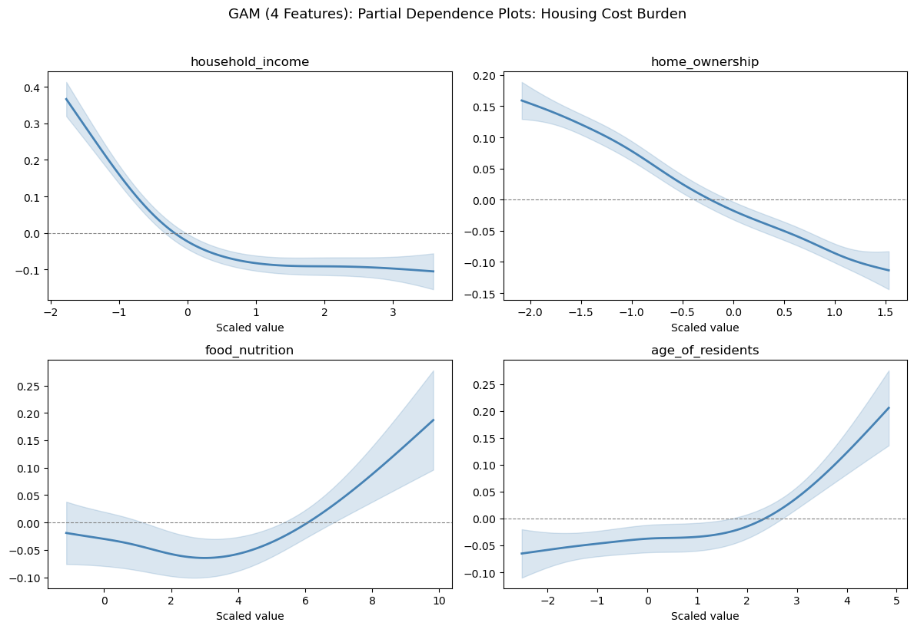

Slide 8
Classification Model Overview
Ayia Boutanassa, Brady Dunn, Bryce Jackson, Eric Testen, Garrison High
05/04
2026
The goal of the regression model is to maximize recall for high displacement risk neighborhoods.
The models trained and built when reaching the optimal model were:
Logistic Regression Model
Random Forest Model
K-Nearest Neighbors (KNN)
XGBoost
The dataset for this project used contained of:
458 observations
23 features
The best model achieved was the XGBoost model with balance in recall and precision.

Slide 9
Classification Model Results (XGBoost)
Ayia Boutanassa, Brady Dunn, Bryce Jackson, Eric Testen, Garrison High
05/04
2026
Top Predictors of Displacement Risk:
Household Income
Food/nutrition Access
Housing Age
Code Violations
Approximate Recall:
Approximate F1:
0.83
0.79
Approximate Average Percision:
This model was chosen as the optimal model due to it having the best balance of percision and recall. It also has the ability to capture nonlinear relationships.
0.88

Slide 10
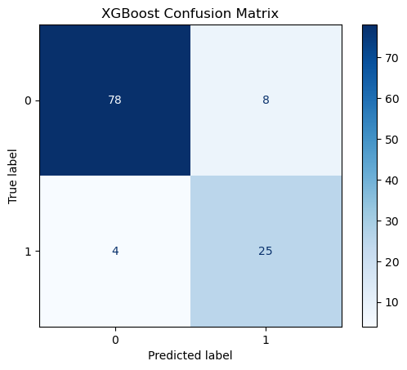

Slide 11
HOLC Equity Analysis
Ayia Boutanassa, Brady Dunn, Bryce Jackson, Eric Testen, Garrison High
05/04
2026
House Unaffordability & Displacement Risk
We also took time to examine whether historical redlining still had any impact on present-day housing outcomes. We found that neighborhoods historically graded C and D had significantly higher housing burden and displacement risk compared to neighborhoods graded A and B.
P-value was shown to be less than 0.05 -> statistically significant
A p-value less than 0.05 means the differences in neighborhood grades are unlikely to be due be random, therefore we can treat it to be meaningful. Most importantly HOLC grade was not used in our models, however, the patterns still appeared. The patterns suggested that the historical inequalities due to redlining are still reflected in current-day socioeconomic conditions.

Slide 12
Conclusion
Ayia Boutanassa, Brady Dunn, Bryce Jackson, Eric Testen, Garrison High
05/04
2026
We learned that housing burden is strongly tied to income, home ownership, and nieghborhood characteristics.
Best performing models:
Generalized Additive Model (GAM)
XGboost Model
These models provided strong predictive performance to help identify high-risk areas.
We found evidence that historical redlining mapping that was initiated in order to mark hazardous neighborhoods in terms of investment still shows impact on current-day neighborhoods.
However, our analysis is still limited by cross-sectional data and does not establish causation. Only association can be established.

